Slide 1
Ocean Sunset
An Animated HD PowerPoint Template

Slide 2
Animated Content Page
This 2010 PowerPoint contains video animation which support text over the top of it. The PowerPoint 2007 version includes video animation, but does not support text on top of the video. The 2003 version does not support video.
All the elements can be modified or removed.
Static versions of all layouts are also available.

Slide 3
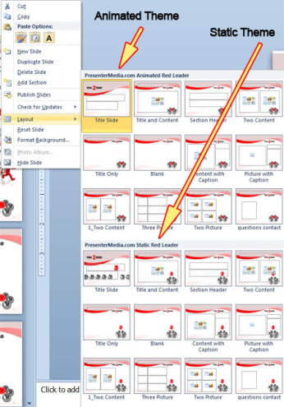
Animated or Static?
You can change between static and animated layouts by clicking on the Layout tab in the HOME menu on the ribbon.

Slide 4
Useful Images and Icons

Slide 5
Agenda or Summary Layout
A second line of text could go here
1
Discussion Item One – A Placeholder for text Add a second line of text here
2
Discussion Item Two – A Placeholder for text Add a second line of text here
3
Discussion Item Three – A Placeholder for text Add a second line of text here
4
Discussion Item Four – A Placeholder for text Add a second line of text here

Slide 6
Print Page Layout
Our website is filled with exciting downloadables, templates, clipart and animations. You can easily switch out the graphics is this template with items from our website.

Slide 7
Bar Graph Page Layout
Here is the description of the graph. This chart is enhanced with features from PowerPoint 2007 or higher.
Here is some more text. You may delete the graphical elements.

Slide 8
Bar Graph Page Layout
Here is the description of the graph. This chart is enhanced with features from PowerPoint 2007 or higher.
Here is some more text. You may delete the graphical elements.
*note*
Double Click on Charts to Change Color.

Slide 9
Sample Table Layout
Geographic Region | Q1 | Q2 | Q3 | Q4
United States | 1254 | 1254 | 1254 | 1254
Europe and Asia | 324 | 324 | 324 | 324
Australia | 32 | 32 | 32 | 32
South America | 2 | 2 | 2 | 2
Canada | 1 | 1 | 1 | 1
Mexico | 1 | 1 | 1 | 1
TOTALS | 1614 | 1614 | 1614 | 1614
Here is the description of the graph. This chart is enhanced with features from PowerPoint 2007 or higher.
Here is some more text. You may delete the graphical elements.

Slide 10
Example Pie Graph
This is a PowerPoint 2007 or higher enhanced graph. You may change this graph as you wish.
This chart utilizes features available in PowerPoint 2007 or higher.

Slide 11
Example Pie Graph
This is a PowerPoint 97 higher compatible graph. You may change this graph as you wish.
This chart can be modified in all versions of PowerPoint.
Post notes and reminders
Here.

Slide 12
Comparison Page
Your Sub Title Here
This is a place holder for item one. Item one can be text, a picture, graph, table, etc. This is a place holder for item one. Item one can be text, a picture, graph, table, etc.
Your Sub Title Here
All the graphical elements can be moved, copied, or deleted from the slide master view.

Slide 13
Smart Art Page Layout
Stage 1
Second level of text here
Second level of text here
Second level of text here
This chart utilizes Smart Art which is feature in PowerPoint 2007 or higher. If you wish to make charts like this and don’t have PPT 2007, we have provided the graphical elements to help you build this yourself.

Slide 14
Smart Art Page Layout
Step 1
Add Supporting Text Here
Step 2
Add Supporting Text Here
Step 3
Step 4
Supporting Text Here
Supporting Text Here
This chart utilizes Smart Art which is feature in PowerPoint 2007 or higher. If you wish to make charts like this and don’t have PPT 2007, we have provided the graphical elements to help you build this yourself.

Slide 15
Picture Layout
You can add a description of the picture here.
In PPT 2007 or newer, this is a custom layout and can be modified under the slide master view.

Slide 16
Three Picture Page Layout
A description of the first picture. You may change this text.
A description of the second picture. You may change this text.
A description of the third picture. You may change this text.

Slide 17
Two Picture Page Layout
A placeholder for the caption under the second picture. You may delete or change this text as necessary.
A placeholder for the caption under the first picture. You may delete or change this text as necessary.

Slide 18
Questions? Comments?
We are happy to help you!
PresenterMedia.com
4416 S. Technology Dr
Sioux Falls, SD 57106
(605) 274-2424

